Slide 1

The SONAR Selection, Operation and NAvigation Radar
PoC - Advanced analytics on site selection
Bozhu Bi
Global data assets and decision science
Updated on Mar. 2021

Slide 2
Agenda
What we did
What we got to know
Current process
Pain points and challenge
What we planned
Revisit the tasks
Renew the timeline
Estimate the cost

Slide 3
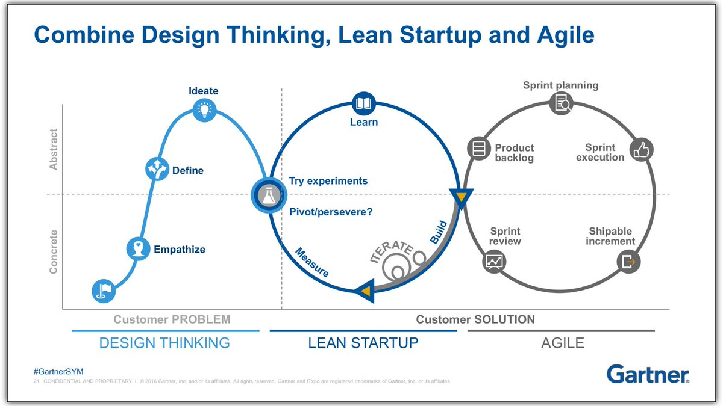

A combination of iterative, experimental methodologies is needed to support digital innovation efforts
Today’s scope
explore the problem + build the right thing + build the thing right

Slide 4

What we have done
Internal stakeholder interview
Global platform testing
Uses cases to test data rationale
External vendors approach
Finalize the project scope, timeline and cost

Slide 5




The way to run the site selection and patient recruitment approach currently was identified.
Global kick off
Global feasibility team offer the recommended site and PI list
CLM refer to historical sites, CDE posting and Citeline to filter out the eligible and highly collaborated sites and PIs
Site feasibility –survey via ISA (and iHUB)
Finalize the site selection and distribute to CRA team
Plan for patient recruitment strategy and contract
CLM monitor the recruitment status with CRA/CRC
Suggest if any deviation from the plan, e.g. PRO, new sites, or sites closing
Global kick off and recommendation
CLM review the protocol and prepare the China sites feasibility
Sites selection and feasibility
Study initiation and CRA site visit on operation
Patient recruitment
…
Protocol review
Leading PI selection with desk research on relevant knowledge regarding360 info, e.g. disease, study, pipeline, literature, other trials
CLM SSV and f2f talk with PI
Protocol feasibility – survey via ISA
CRA site visit and collect patient journey, following the checklist by CLM
SSU

Slide 6

Current pain points and challenges were visible from team, organization and environment.
Team/People
Bayer/Global
Environment/China regulation
More on experience-based model
High heterogeneity on people experiences and capacity
High variety of site efficiency management
Challenged by productivity enhancement (country factor), reflecting on sites productivity, resources productivity etc.
Challenged by increasing demands on new disease areas and innovative pipeline
China clinical trial sites filing system motivates more sites to join the clinical trails (720 -> 1022 now*)
Increasing size of clinical trials in China make the sites resources more competitive, in terms of patients and GCP resources.
Source: the sites of clinical trial from 2016 to 2018 is ~720, and It is 1022 sites filing in the CDE till end of 2020.
Notes:
长治医学院附属和平医院药物临床试验机构
为促进药品医疗器械产业结构调整和技术创新，提高产业竞争力，满足公众临床需要，中共中央办公
厅、国务院办公厅于2017 年10 月印发了《关于深化审评审批制度改革鼓励药品医疗器械创新的意见》（厅
字〔2017〕42 号）（简称“两办意见”），其第一条意见要求临床试验机构资格认定实行备案管理[1]。2019
年，新修订的《中华人民共和国药品管理法》（简称《药品管理法》）第十九条增加了“药物临床试验机构
实行备案管理”的表述，使药物临床试验机构（简称机构）备案管理从法律层面得以落地。根据新修订的《药
品管理法》，国家药品监督管理局（简称国家药监局）会同国家卫生健康委员会制定《药物临床试验机构
管理规定》（简称《机构管理规定》），由国家药品监督管理部门负责建立“药物临床试验机构备案管理信
息平台”（简称机构备案平台），用于机构登记备案和运行管理，以及药品监督管理部门和卫生健康主管部
门监督检查的信息录入、共享和公开[2]。受国家药监局委托，国家药品监督管理局食品药品审核查验中心（简
称核查中心）具体承担机构备案平台的构建、运行维护及备案资料的审核工作。本文根据《机构管理规定》
等相关法规，介绍机构备案平台的组成及相关备案要求，对机构在备案过程中存在的常见问题进行了总结
和探讨。
针对当前临床试验大多集中在大型“三甲”医院的
问题，有必要将部分临床试验分流至非“三甲”医院投资
建设的临床试验中心。建议备案制实施后，首先应在国
家药监局备案系统中，按照机构的能力和所承接临床试
验的类型加以分类，向社会公开备案的机构信息，便于
申办方筛选。其次，药品监管机构要做好针对制药企业
和CRO的宣传工作，制药行业协会也应积极引导，鼓励
申办方根据自己的临床试验的级别和特点，评估试验风
险，选择合适的临床试验机构。既要避免机构的选择集
中在综合实力强的“三甲”医院，增加机构负担，影响临
床试验质量和进度；又要避免其他机构的闲置和浪费，
使临床试验资源充分有效地利用起来，加快药物的上
市，保障患者的用药需求和用药安全。

Slide 7
Some key facts
1
Since 2018, the clinical trials in China increased sharply.
2
~20% sites with very limited patients, 0 or 1
3
Most of studies recruited 80% of patients with 40%~60% sites
Patients #
X% of sites contribute 80% patients
Registered trials #
Concentration analytics
Distribution of Sites # by patient recruitment
Sample size
Source: China registered studies in CDE
Source: Bayer studies in China
Source: the historical Bayer studies with sample size >100 in China
Notes:
长治医学院附属和平医院药物临床试验机构
为促进药品医疗器械产业结构调整和技术创新，提高产业竞争力，满足公众临床需要，中共中央办公
厅、国务院办公厅于2017 年10 月印发了《关于深化审评审批制度改革鼓励药品医疗器械创新的意见》（厅
字〔2017〕42 号）（简称“两办意见”），其第一条意见要求临床试验机构资格认定实行备案管理[1]。2019
年，新修订的《中华人民共和国药品管理法》（简称《药品管理法》）第十九条增加了“药物临床试验机构
实行备案管理”的表述，使药物临床试验机构（简称机构）备案管理从法律层面得以落地。根据新修订的《药
品管理法》，国家药品监督管理局（简称国家药监局）会同国家卫生健康委员会制定《药物临床试验机构
管理规定》（简称《机构管理规定》），由国家药品监督管理部门负责建立“药物临床试验机构备案管理信
息平台”（简称机构备案平台），用于机构登记备案和运行管理，以及药品监督管理部门和卫生健康主管部
门监督检查的信息录入、共享和公开[2]。受国家药监局委托，国家药品监督管理局食品药品审核查验中心（简
称核查中心）具体承担机构备案平台的构建、运行维护及备案资料的审核工作。本文根据《机构管理规定》
等相关法规，介绍机构备案平台的组成及相关备案要求，对机构在备案过程中存在的常见问题进行了总结
和探讨。
针对当前临床试验大多集中在大型“三甲”医院的
问题，有必要将部分临床试验分流至非“三甲”医院投资
建设的临床试验中心。建议备案制实施后，首先应在国
家药监局备案系统中，按照机构的能力和所承接临床试
验的类型加以分类，向社会公开备案的机构信息，便于
申办方筛选。其次，药品监管机构要做好针对制药企业
和CRO的宣传工作，制药行业协会也应积极引导，鼓励
申办方根据自己的临床试验的级别和特点，评估试验风
险，选择合适的临床试验机构。既要避免机构的选择集
中在综合实力强的“三甲”医院，增加机构负担，影响临
床试验质量和进度；又要避免其他机构的闲置和浪费，
使临床试验资源充分有效地利用起来，加快药物的上
市，保障患者的用药需求和用药安全。

Slide 8

Less Sites, More Patients
_____
More precise, efficient and concentrated sites
More diversified patient source
Higher productivity
Superior positioning in globe

Slide 9
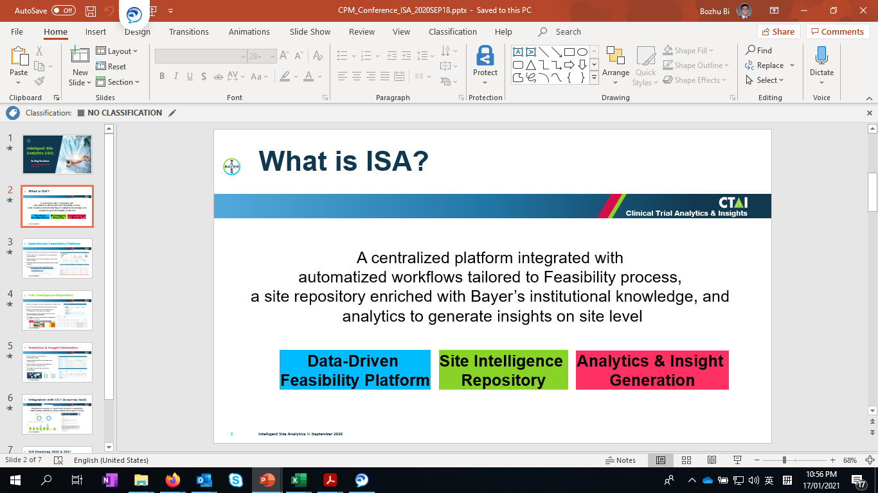
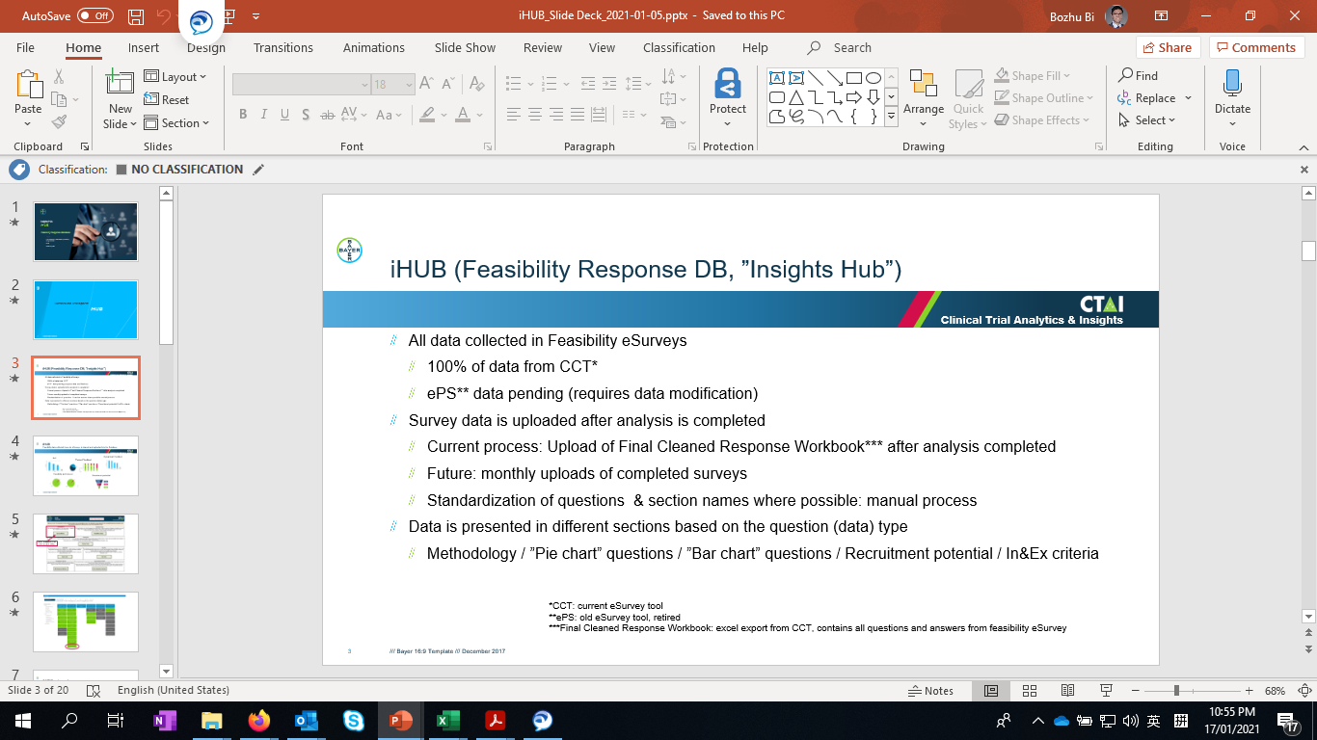
Currently global feasibility platform and tools focus more on the process efficiency and 360 survey analytics.
Fully adopted by China team NOW
Global kick off and recommendation
CLM review the protocol and prepare the China sites feasibility
Sites selection and feasibility
Study initiation and CRA site visit on operation
Patient recruitment
…
Intelligent Site Analytics (ISA)
iHUB – Insights Hub of Feasibility Response

Slide 10
Based on existing global services, we still need to make adaptation and develop China-oriented solutions.
R3 - Recommend, Review and Recruit
Covered by global ISA platform
China customized needs now
Recommend & Review
Recruit
Investigator survey
Internal experience key-in
Old sites review
Objective operation performance
Internal Data synergy
External China data synergy (e.g. sales, RWD)
Patients recruitment channels and approaches
New sites operation profile
Patients searching intelligence
New sites
New investigators profile
Rationale
Aligned scientific measurement
Experience based decision
Channel efficiency

Slide 11

Go with solid objective
To locate the eligible patients in clinical trial in a quick manner and further support the product faster to go to market.
Data driven/Hybrid suggestions
_____
Benefit from
Moving from siloed data to integrated platform
Transforming human experience to empowered by data
Empowering the insights by advanced analytics
Cultivating the sharing culture to contribute under framework

Slide 12





SONAR framework
Protocol feasibility
Patient feasibility
Investigator feasibility
SSU feasibility
Protocol evaluation tool
Regional potential
Site potential
Eligible patient potential to reflect in/exclusion in protocol
Competitor intelligence
Recruitment simulation
Collaboration intelligence
Research interest
Investigator experience
Site timeline, e.g. time to FPFV
Site quality, e.g. queries per patient, days for queries closure
Site productivity, e.g. enrolment rate per month

Slide 13
Less - more precise - more efficient sites, more patients
Global practices and platform
ISA platform
Survey and iHUB
Focus areas
1
2
3
4
Preparation
Site and PI listing
Patient journey
Patient recruitment
less, more precise, more efficient
Unmet needs
Similar trial info extraction
Sites
Visit process
Digital promotion
Historical operational performance by site level
Referral network
走进社区
Protocol deep dive
How the sites GCP dept is positioning
PI
Key dept identification, e.g. 糖化室，动态心电图
PRO
360 knowledge sync on PI and study
How the PI react to studies or our studies
Channel diversity
How are their collaboration network
Patients
基因检测
The relevant product sales are relevant
淋巴瘤之家
The physician size is relevant
咚咚癌友圈
Digital Solution
Information extraction
Low performing sites identification
Sites-PI profiling and classification
Patient journey digitalization and referral network
Precision promotion
Semantic search
HUBBLE/Citeline
Chatbot
Notes:
In/exclusion criteria
一线，二线
用药组合，单药/联合用药，一线/二线/其他，初治/复发难治，获批的适应症等等
查看新入选的医院 名单
附属和平医院入选国家药物临床试验机构， 7月17日，国家药品监督管理局公布新增87家药物临床试验机构，我校附属和平医院入选其中，认定的专业为血液内科、心血管内科、神经内科、呼吸内科、骨科、泌尿外科、麻醉、眼科、放射治疗、耳鼻咽喉、肿瘤、传染、普通外科、免疫学、内分泌、肾病内科。迄今为止，全国药物临床试验机构总数已超700家。

Slide 14
In the phase1, we will focus on deliver a decision model on site selection empowered by incorporating internal and external data.
1
2
3
Site list and corresponding evidence offered by external vendors
Correct the internal data
Make decisions
Locate the sites with high potential with large patient pool and operation performance
Site selection empowered by internal and external data
Analytics
Internal data
Internal data
Transfer the patients to Bayer studies
Accelerate the patient recruitment by data and analytics
Recruitment progress prediction and alert
Internal data
External data
External data
Internal data
Internal data
* External data refers to the sites and investigators performance data from strategic partner, to enhance the internal data coverage in specific perspectives
External data

Slide 15

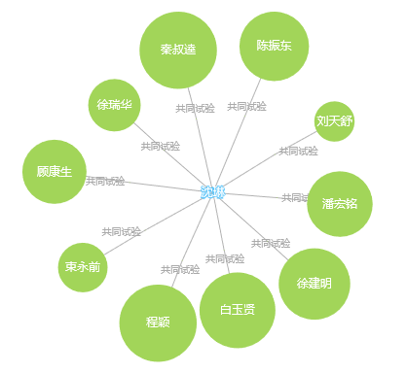
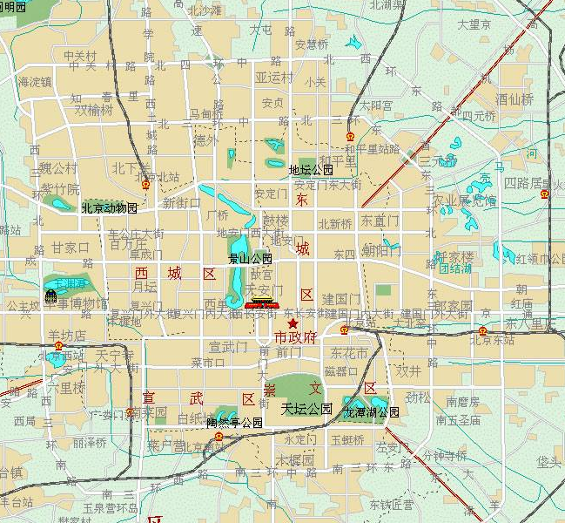
Task 2, PI referring and site-less sites recommendation
Scope
Timeline
Identify the sites with geographical adjacency
Identify the sites-PI with collaboration network (clinical trials)
PRO+CRA
2021Q1
“对于心衰以及慢病领域，很多患者都分布在社区卫生中心，可以通过市场部走进社区的活动，进一步推荐患者“
“肿瘤跟慢病不太一样，医生还是主要考虑患者的治疗获益的，并且患者特别认医生，有些医生的power非常大，会推荐到大的PI，比如沈琳，并且现在主要想通过更集中的site，更深度的合作来收集更多的患者，不把时间和精力放在开关sties上“
5km
Notes:
https://medcitynews.com/2017/06/low-performing-trial-sites-choose-revision-not-rejection/
Know your history For sponsors, information is key. Sponsors must get off on the right foot by using historical data to begin their site search. Imagine a coach assembling an all-star basketball team from today’s current pool of NBA players. Most coaches wouldn’t blindly select players they know. Instead, they’d likely research which players work best for their team’s needs. That same mentality should go into site selection. Our company is often brought in during “rescue mode” to help get studies with low enrollment numbers back on-track. What we’ve typically seen is that sponsors have gone with sites they’ve worked with in the past even though they were not a good fit for the study.
Start talking While historical data helps, it’s only the start. Sponsors must start a frank discussion with each site they identify, looking at their strengths and weaknesses. If sites performed well on one study but poorly on another, then sponsors should discuss what was the difference between the two studies. If a study’s protocol does not match the site’s specialty, then it will become apparent to both parties that they may not be the best fit.

Slide 16
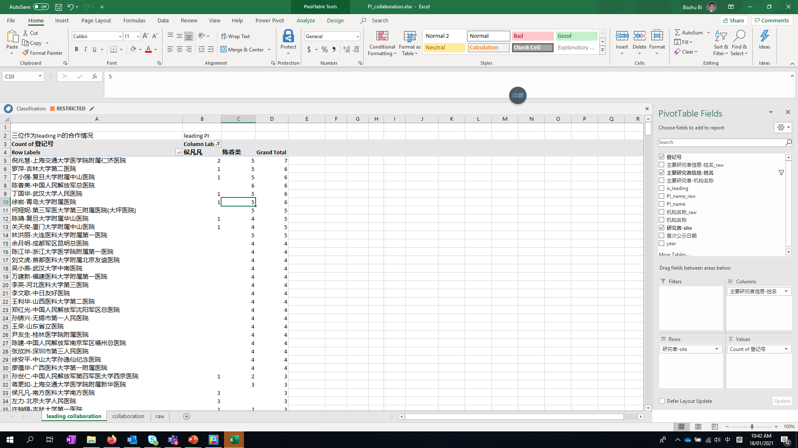
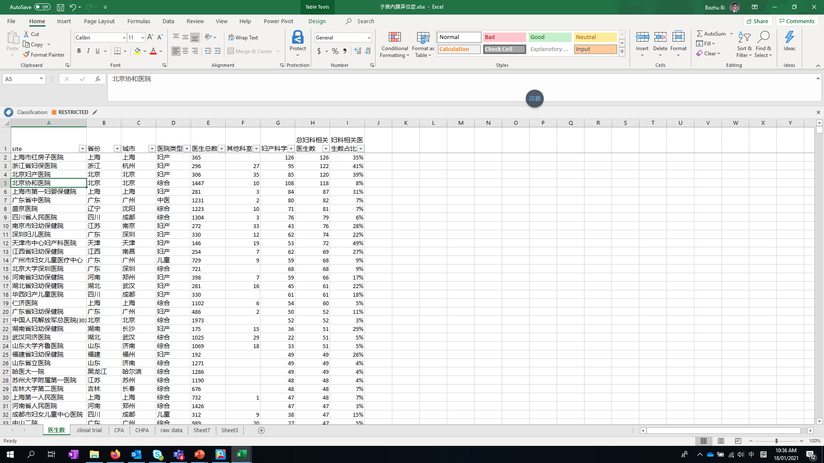
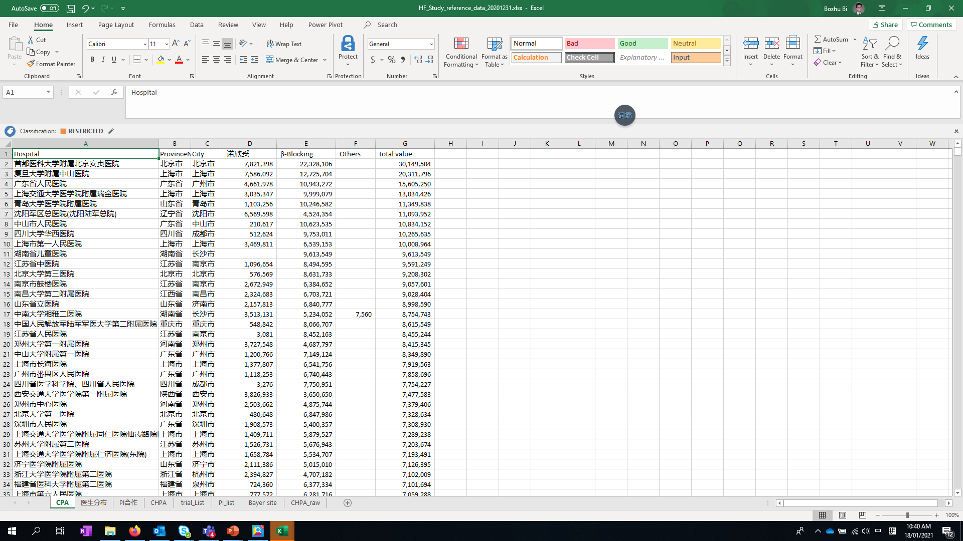
Task 1, raw data synchronization and rule-based reference
Scope
Timeline
Data synchronization and cleansing
Develop data report following the common rules and practices extracted from use cases
Visualized reports
2021Q1
“对于吉林的site选择，如果提前了解，应该尝试吉林大学第二医院，而不是按XXX选择了吉林大学第一医院”
“这些数据还是非常有用的，我会先从药品的量先看起，来协助review我们当前的list，并且会进一步挑选相应的医生的列表给到CRA，让他们去联系医生”
“从临床试验合作的情况来看，也能表示PI的合作关系，比如 韩主任只做leading PI, 。。。与中山关系不好，过往来看基本没有合作”
CKD
Women health
Heart failure
Notes:
https://medcitynews.com/2017/06/low-performing-trial-sites-choose-revision-not-rejection/
Know your history For sponsors, information is key. Sponsors must get off on the right foot by using historical data to begin their site search. Imagine a coach assembling an all-star basketball team from today’s current pool of NBA players. Most coaches wouldn’t blindly select players they know. Instead, they’d likely research which players work best for their team’s needs. That same mentality should go into site selection. Our company is often brought in during “rescue mode” to help get studies with low enrollment numbers back on-track. What we’ve typically seen is that sponsors have gone with sites they’ve worked with in the past even though they were not a good fit for the study.
Start talking While historical data helps, it’s only the start. Sponsors must start a frank discussion with each site they identify, looking at their strengths and weaknesses. If sites performed well on one study but poorly on another, then sponsors should discuss what was the difference between the two studies. If a study’s protocol does not match the site’s specialty, then it will become apparent to both parties that they may not be the best fit.

Slide 17
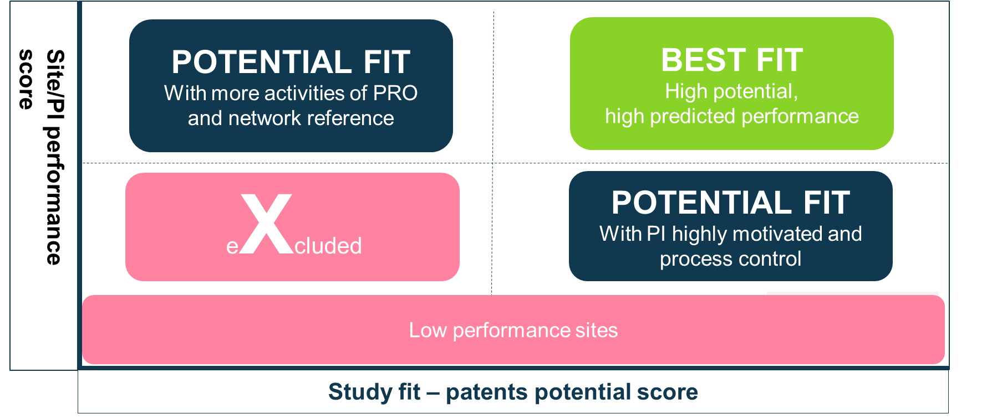
Task 3, Low performing sites prediction and intelligent sites recommendation
Scope
Timeline
Develop the sites profile and scientific scoring model
Develop classification model
Develop scientific scoring model and recommendation engine
2021Q2
“通常每个研究也会有20%左右的sites 只招募到1个患者，甚至完全没有产出，但开关中心仍然需要同样的流程和时间，非常没效率“
“希望能够给site根据相应的指标进行分级，方便大家有一致的标准，也方便大家进行input”
Notes:
https://medcitynews.com/2017/06/low-performing-trial-sites-choose-revision-not-rejection/
Know your history For sponsors, information is key. Sponsors must get off on the right foot by using historical data to begin their site search. Imagine a coach assembling an all-star basketball team from today’s current pool of NBA players. Most coaches wouldn’t blindly select players they know. Instead, they’d likely research which players work best for their team’s needs. That same mentality should go into site selection. Our company is often brought in during “rescue mode” to help get studies with low enrollment numbers back on-track. What we’ve typically seen is that sponsors have gone with sites they’ve worked with in the past even though they were not a good fit for the study.
Start talking While historical data helps, it’s only the start. Sponsors must start a frank discussion with each site they identify, looking at their strengths and weaknesses. If sites performed well on one study but poorly on another, then sponsors should discuss what was the difference between the two studies. If a study’s protocol does not match the site’s specialty, then it will become apparent to both parties that they may not be the best fit.

Slide 18
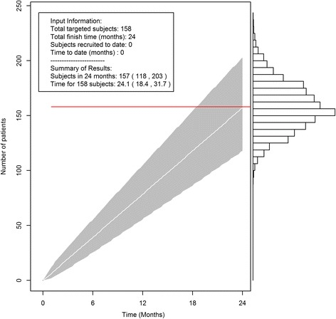
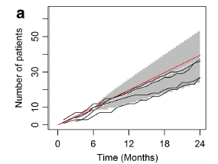
Task 4, model-based patient recruitment planning and recruitment risk alert
Scope
Timeline
Predict the targeted study duration during initiation
Simulate and predict the patient recruitment at interim review, to support the strategy adaption
2021Q3
“更精准的预测和控制study的进展，也方便我们及时调整策略以及总结经验“
Example
Planning at initiation
Monitor and predict during interim review

Slide 19
We will fully leverage internal resources to develop SONAR, with external data enrichment.
Internal solution
External data enrichment
More customized solution
Flexible design
More granular internal data
Highly integration with global platform
Precision promotion by internal channels
Lower cost
More site performance data from SMO

Slide 20

Proposed Timeline for SONAR
~3 Months of Activities for phase 1 | delivery in mid of May 2021
2021
Mar
Apr
May
Jun
Jul
Data cleansing
Internal data sync
Data mapping
Data cleansing
External data strategic collaboration
strategic data collaboration
vendor scanning
Deliverable 1
Data integration and reference data
Data sync and logic design
Deliverable 2
Tableau data
Recommendation model
Feature ranking survey
Site recommendation engine
Deliverable 3
Recruitment risk prediction
Recruitment planning
Deliverable 4
Recruitment alert
UAT and Deliverable polish with end-users
Tableau report during PoC phase
Notes:
Share reference data for VMS study decision
Validate by 17530&6244
Support RUCC and Kandy

Slide 21
Proposed Timeline for SONAR
~3 Months of Activities for phase 1 | delivery in mid of May 2021
2021
Mar
Apr
May
Jun
Jul
Data cleansing
Internal data sync
Data mapping
Data cleansing
External data strategic collaboration
strategic data collaboration
vendor scanning
Deliverable 1
Phase 1- Task 1
Data sync and logic design
Deliverable 2
Tableau data
Phase 1- Task 3
Feature ranking survey
Site recommendation engine
Deliverable 3
Task 4
Recruitment planning
Deliverable 4
Recruitment alert
Task 2
Referral network
Share reference data for VMS study decision
Validate by 17530&16244
Support RUCC and Kandy
Validate the correlation between features (incl. patients potential, site start up days) and final recruitment
Low performing sites could be predicted
Not in the list of predicted sites (part of or all)
Notes:
Share reference data for VMS study decision
Validate by 17530&6244
Support RUCC and Kandy

Slide 22
Business values and efforts estimation
Total cost :
35k euros phase 1
15k euros phase 2
Global kick off and recommendation
CLM review the protocol and prepare the China sites feasibility
Sites selection and feasibility
Study initiation and CRA site visit on operation
Patient recruitment
Study initiation and CRA site visit on operation
Patient recruitment
1
1
1
1
2
2
…
3
3
4
4
Business values
Internal resources
External resources
Total cost
Task1
Raw data synchronization and rule- based reference
Could be referred through whole process, including sites suggestion engine, review existing sites, quickly pick up new sites in case of any risk alert etc.
Support decision making in a TIMELY manner
Quick win
data synchronization,
business case deep dive,
design the data rationale and dashboard.
Labor work in data cleansing
PD: 20 days
In-Costs: 9,280 euro
Ex-Costs:10,000 euro
1
Task3
Low performing sites prediction and intelligent sites recommendation
Could support more intelligent sites suggestions with rich data sources and AI models
Could be taken as aligned measurement to support solid decision making
Data modeling
External site performance data from SMO (nice to have)
PD: 20 days
In-Costs: 9,280 euro
Ex-Costs: 6,000 euro
Task4
model-based patient recruitment planning and recruitment risk alert
Could support scientific study duration planning
Could be smarter alert on recruitment risk
Data modeling
PD: 20 days
In-Costs: 9,280 euro
As above
2
Task2
PI referring and site-less sites
recommendation
Could support the diversity of patient recruitment, mitigating the risk of recruitment failure on sites
Could support the precise list for CRA to work on the patient recruitment and better collaboration with PRO
Data analysis
None
PD: 10 days
In-Costs: 4,640 euro

Slide 23
To achieve the success measured by
Let us brainstorm and discuss
Avoid low performance sites
20%
The time to make informed decisions
30%
The internal and external cost saving
$XXX
The adoption of PoC for the new studies
100%
GO with SONAR to select sites with scientific recommendation

Slide 24
Backup

Slide 25

To accelerate sites selection, the 3-dimensions measurement would be employed with quantified features
Fully leverage historical data and experiences
Required Documents #
Involved depts #
Contract duration
Historical SSU days
Queries response days
Etc.
Estimated sites #
Potential eligible patients #
Competitor studies
Management cost per site
Other additional admin process
Speed
Dimensions
Cost
SONAR
Investigators collaboration – interest & intension
Investigators profile and experience
Data quality of historical studies/ issues #
Drop out rate & Screen failure rate
Quality

Slide 26


How the flow will be changed
Protocol feasibility
Patient feasibility
Investigator feasibility
SSU feasibility
TODAY
Medical domain/ experience driven
Questionnaire based
Questionnaire based
Guess work
Manually integrate siloed info by project
Network and experience driven
Excel documents
Be risky to be modified
Knowledge attrition with people shift
FUTURE
NLP assisted
Hybrid expert survey and data evidence driven
One-stop internal & external data hub
Scientific modeling for site potential
Quantified mindset
Investigators 360 info
Fully online data
Knowledge hub with synergy of internal and external data
Digitalize the historical sites
Make new sites tangible with one-click
Access to new disease area with 360 info

Slide 27





Site selection roadmap with advanced analytics PoC and product platform
High-level milestones
PoC with data assets and advanced analytics
PoC optimization and prototype initiation
Business needs clarity
Data integrity and advanced analytics
Product Platform
Business led by Joeann Fan, R&D
Digitalization led by Xiangfei Meng
Contributed by Bozhu Bi/Chao Ma/Hao Zhang/other team members
Nov~Dec, 2020
Dec, 2020 – Jan,2021
Feb, 2021
Data stream interface
…
Application and system development
2020
Business led by Joeann Fan, R&D
Digitalization led by Bozhu Bi
Contributed by Xiangfei Meng/Chao Ma/Hao Zhang/other team members
2021

Slide 28
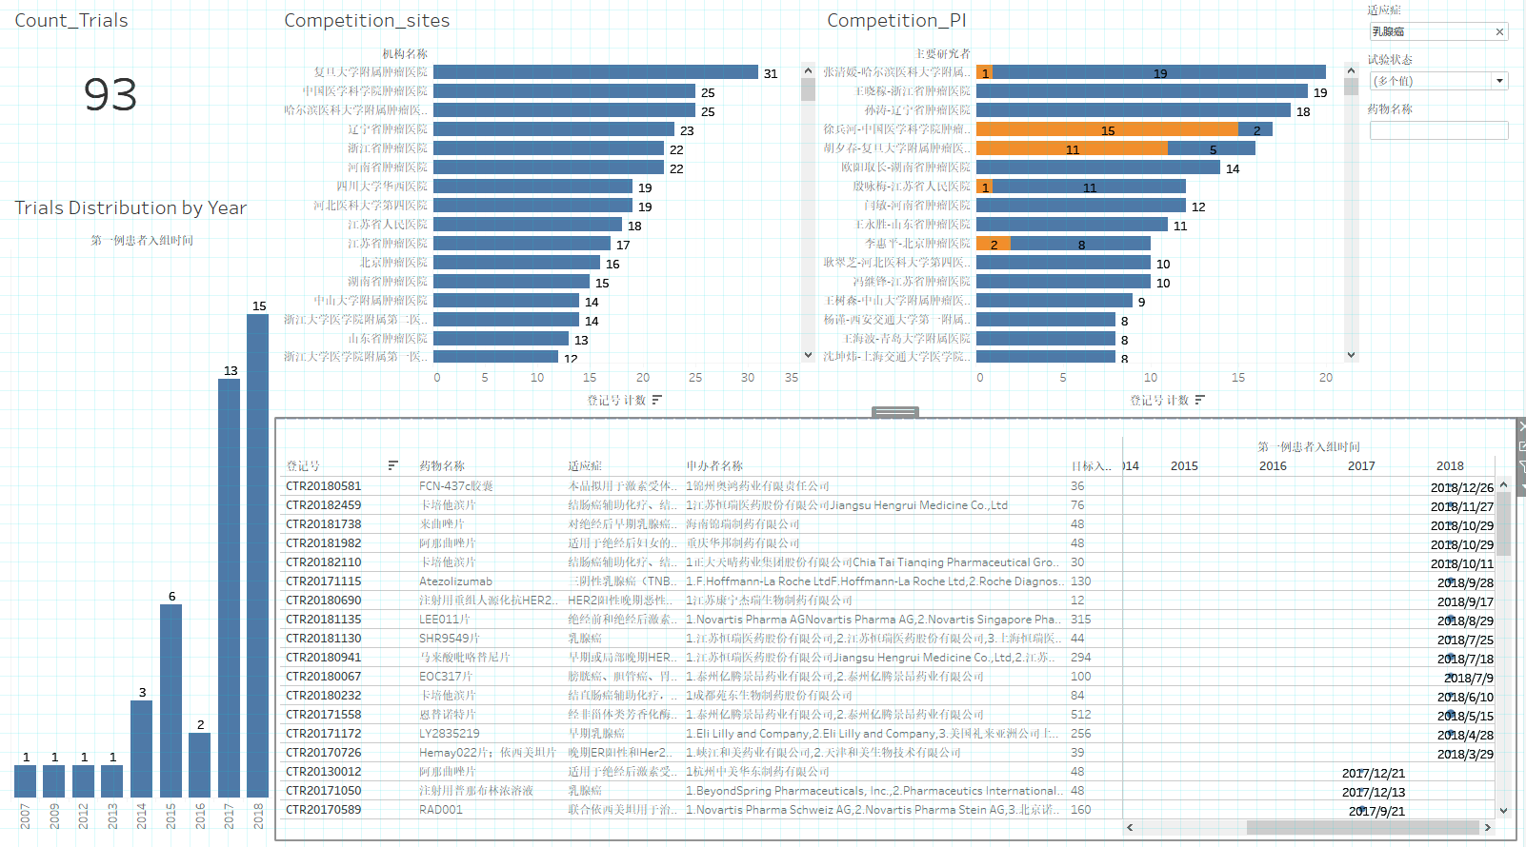
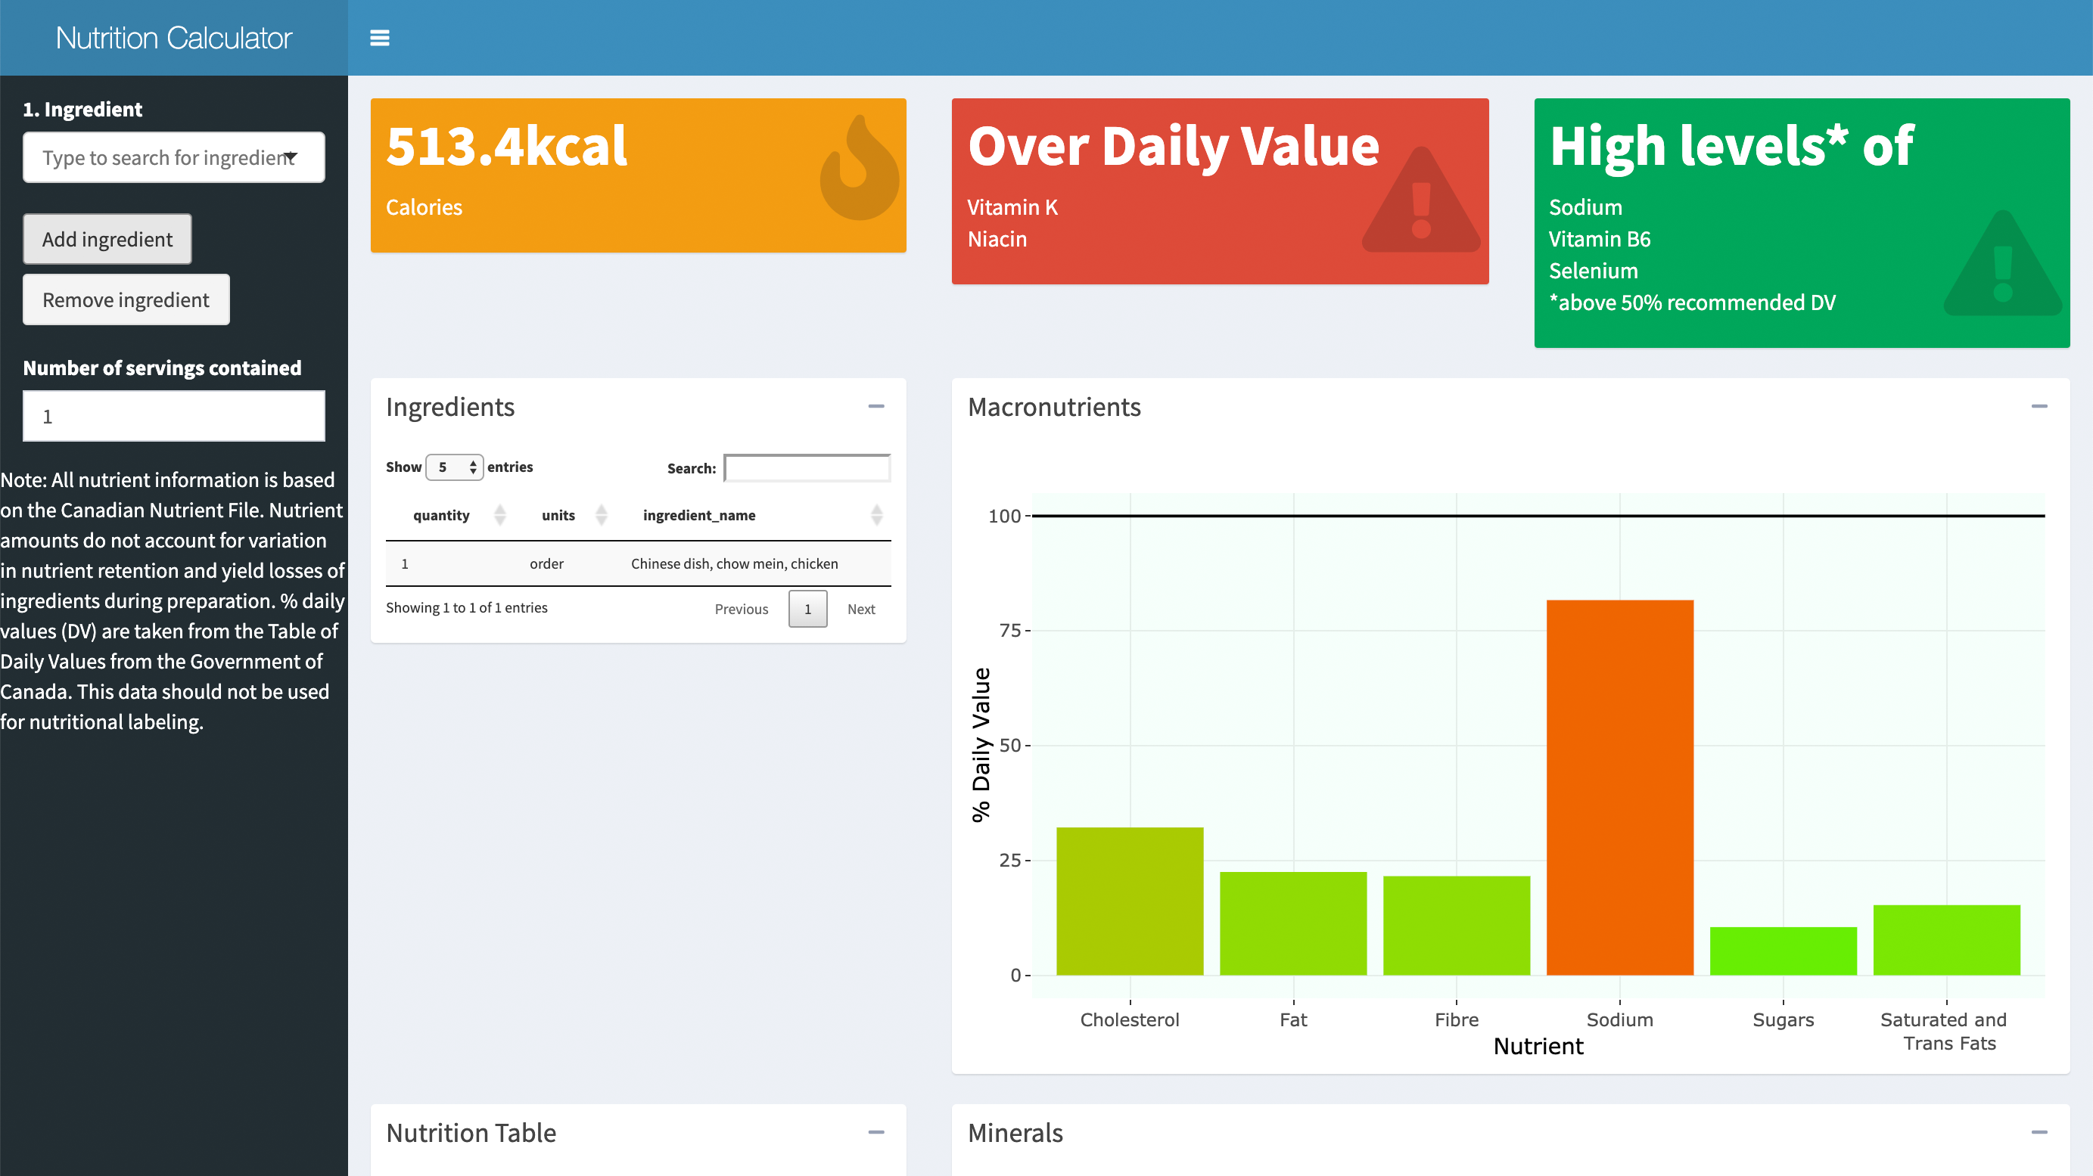
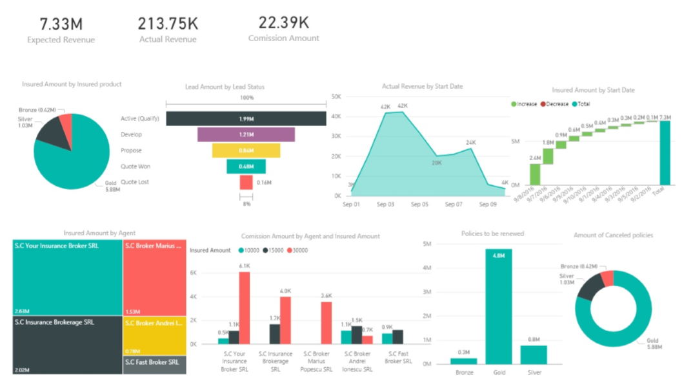
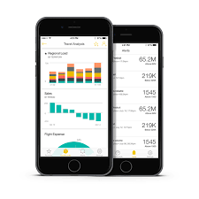
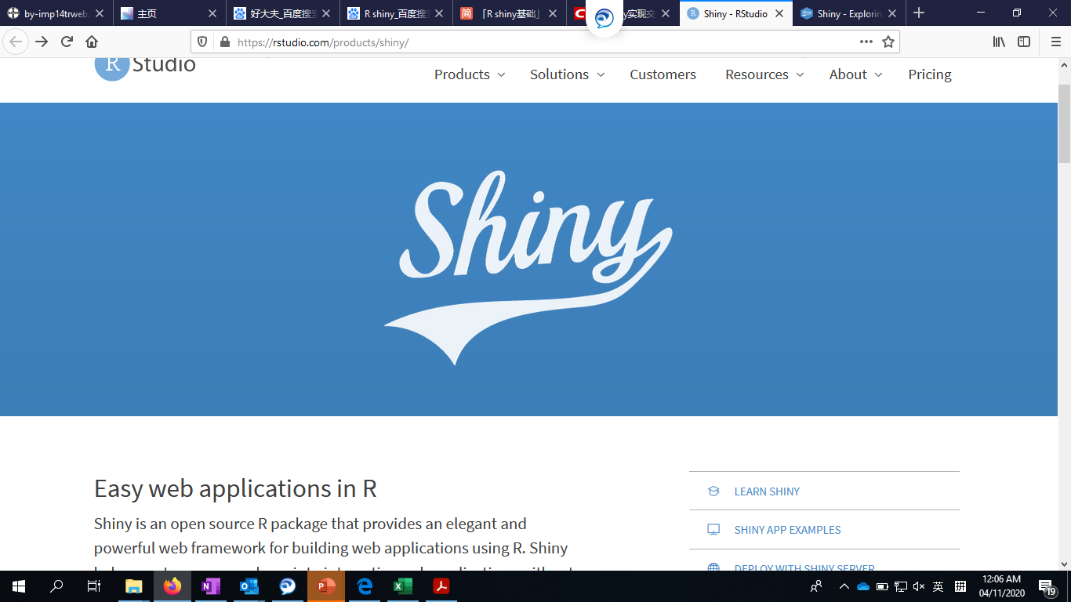








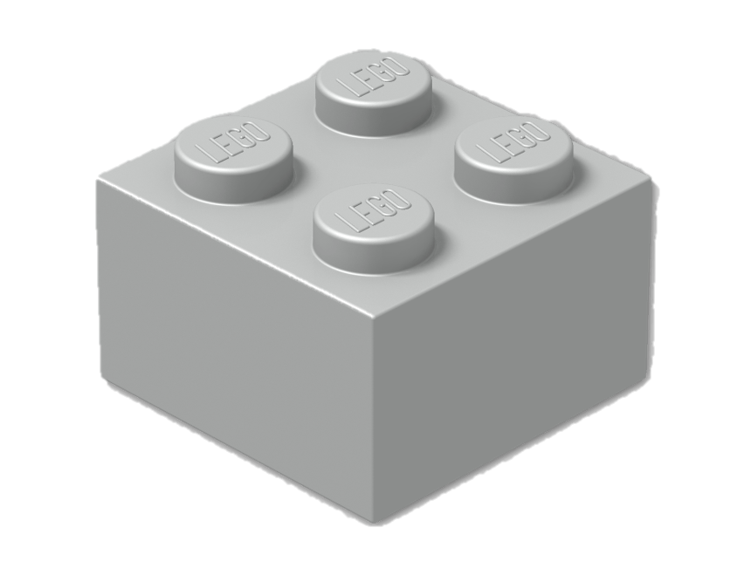
PoC delivery will feed product platform as core data assets.
PoC phase
Product
Fit to product design
Delivery
Tableau
Web
Mobile
Analytics box
Embedded to product and fit the product infrastructure
Analytics box
Data stream interface
Industriliazation
Experiment
Internal data sources
External data sources
Carry over and automate the data streams
System data foundation
Other data sources, e.g wechat
Data Sources
360
Data structure interface
Data flow
…
Data hub
Data structure

Slide 29
Analysis

Slide 30
Protocol feasibility
Deep dive
Objective
To facilitate generating the inclusion and exclusion criteria by referring to the historical relevant ones
To facilitate tuning the parameters of in/exclusion criteria to accelerate the recruitment rate
Data required
Clinical trials in https://clinicaltrials.gov/
China clinical trials registry http://www.chinadrugtrials.org.cn/index.html
PROTOCOL
Protocol evaluation tool
Analytics
Topic clustering analysis to group all the relevant criteria together, e.g. identify all the medical history records in each study , e.g.有精神病史，药物滥用史，药物依赖史//有精神病史，药物滥用史，或吸毒史 // 既往吸毒史，药物滥用史，尿药筛查阳性者
Knowledge extraction, e.g. 入选前至少12个月内最近的超声心动图和/或心脏MR提示左心室射血分数（LVEF）>40% -> LVEF: >40%

Slide 31
Patients
Deep dive
Objective
To estimate potential patient size in a data-driven way (sales data indirectly)
To simulate the patient recruitment duration by modeling, considering historical enrollment rate and competition status
Data required
Product level data by district
Product level data by site
EMR data in real world
Hospital master data, e.g. hospital beds, patients visits # per year, physicians # by TA etc.
Site trove data
Patients
Regional potential
Site potential
Eligible patients potential to reflect in/exclusion in protocol
Competitor intelligence
Recruitment simulation
Analytics
Products size estimation by existing sample data and master data, e.g. estimate Xarelto size of hospital B utilizing known 800 hospitals
Simulate the patient recruitment duration by utilizing the MonteCarlo model
Predict the low performing sites and identify the risk factors by machine learning

Slide 32
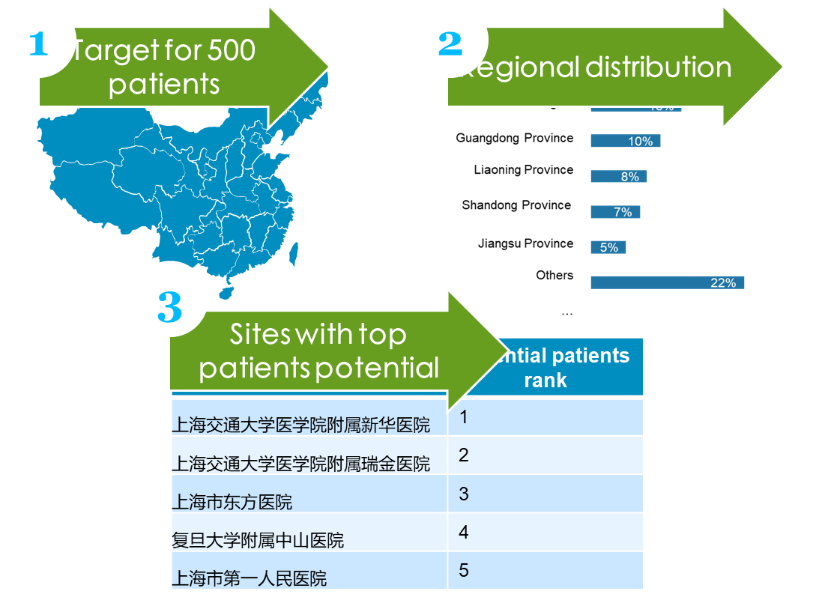
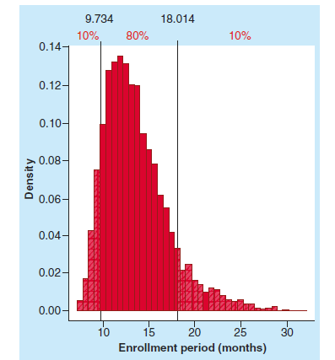
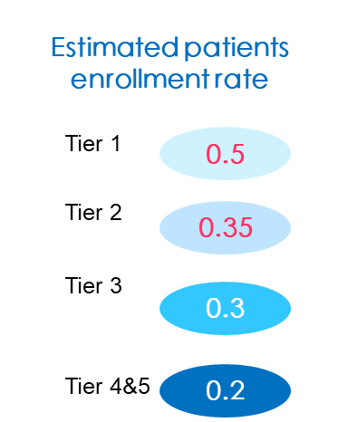
A data driven way to estimate the patient size by site and simulate the potential patient enrollment duration
Estimate site potential by region and recommendation
Estimate enrollment rate
Simulate enrollment duration
Split the total patients by regions using CHPA data, to ensure the regional representativeness
Estimate the sites potential by CPA hospital data, referring to the hospital beds, physician size (好大夫)
Considering the competition study (CDE data) and past enrollment rate (internal experience, Trialtrove data), estimate the enrollment rate by tier
Considering the competition study and past enrollment rate, estimate the enrollment rate by tier, e.g. 80% probability the patient recruitment will be closed within 18 months.

Slide 33
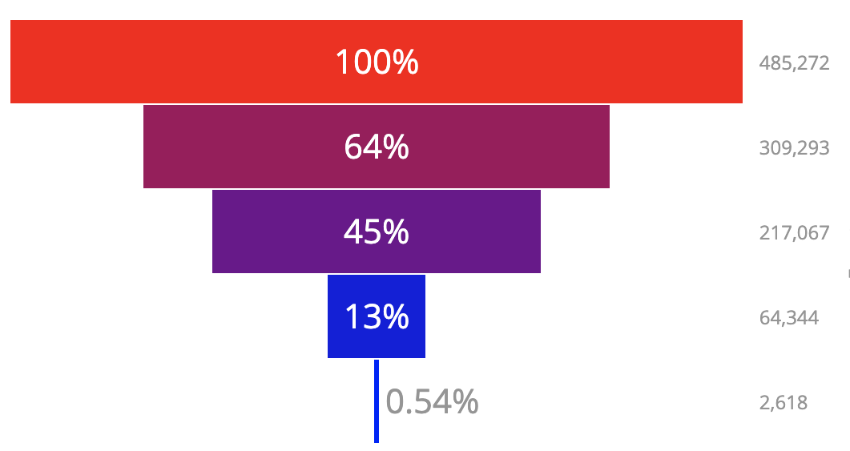
Real world data with “one study, one script” under OMOP framework
CHALLENGE
DATA / APPROACH
Delivery
Nowadays patients size estimation are mostly indirect estimation by alternative data (e.g. commercial data), and even by guess work.
It is still challenging in estimating the patient size matching in/exclusion criteria level in the protocol
It is far from optimizing the protocol to accelerate the patient recruitment with real world evidence
Leverage the real world data to have a deep view to the eligible patients in protocol, in a micro way
The sites used to decline to move the data out of sites to ensure the data privacy, OMOP common data model fits such scenario as global open source project recognized by US and EMA countries.
As key component of OMOP, real world data in sites should be mapped into common data model.
Send the user-defined script to run as expected.
Generate the attrition flow
Have the sensitivity test with different cut-offs
33

Slide 34
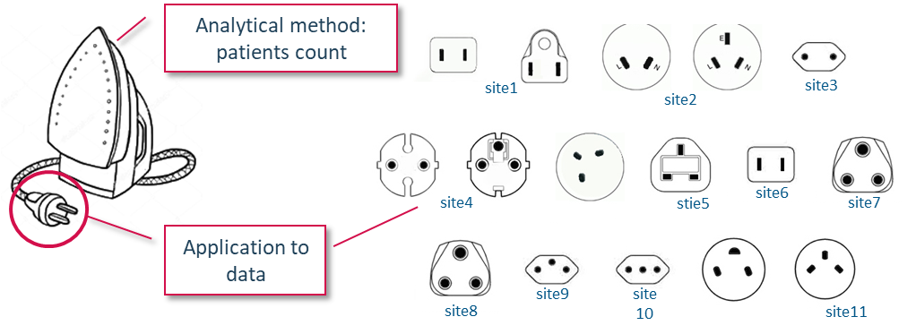
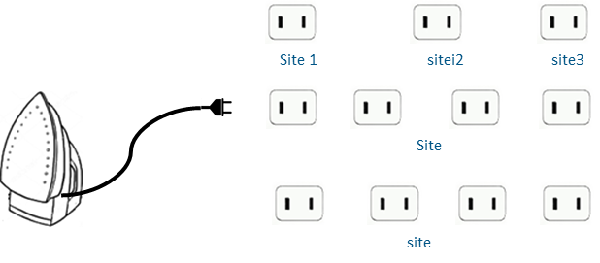
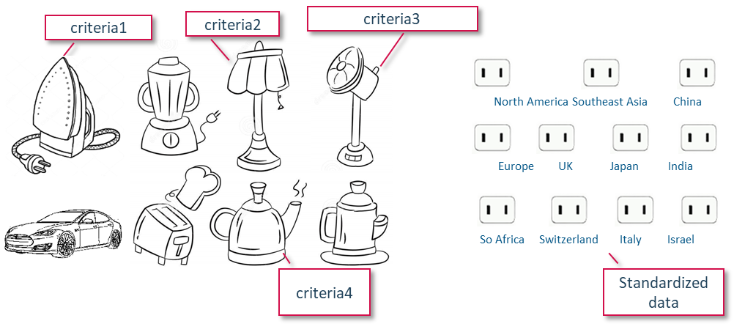
Real world data with “one study, one script”
34

Slide 35
Investigators
Deep dive
Objective
To match the investigators with the most aligned research interest
To explore sub-I with the most closely collaboration with leading PI
Data required
China clinical trials registry http://www.chinadrugtrials.org.cn/index.html
Past collaboration with Bayer
Publication data, esp. articles, key words, meSH
Investigators
Collaboration intelligence
Research interest
Investigator experience
Analytics
NLP on the publication extraction
Descriptive analytics

Slide 36
Sites
Deep dive
Objective
To summarize the site experience in the past
To offer one-stop information on site profile and contact
To quickly handle the feedback of sites and generate key alert info for other members
Sites
Sites operation excellence
Sites feedback intelligence
Data required
Data of 药研社 on sites profile and corresponding contact info
Internal operation data for features extraction
Internal engagement data with sites in the past, including the comments, days to respond
Analytics
Topic modeling, automate category generation, and sentimental analysis for each comment
Predict with features

Slide 37
Navigation radar will offer a 360 view to evaluate the sites and investigators in a quantified way with scientific ranking.
Dimension | Measurement | Rating
Protocol feasibility |  | 100
Patients feasibility | Patient size | 90
Investigator feasibility | Required Documents # | 60
Site feasibility - speed | Required Documents # | 50
 | Involved depts # | 50
 | Contract duration | 40
 | Historical SSU days | 40
 | Queries response days | 40
Site feasibility – quality | Data quality | 50
Site feasibility – cost |  | 50
ILLUSTRATED
ILLUSTRATED
Weight assigned by
Analytic Hierarchy Process
Final recommendation score
Site-PI 1:
85
Site-PI 2:
65
Site-PI 3:
65

Slide 38
Transform sites selection in a hybrid way driven by both data and experience.
Sites list will be selected step by step ->
1
2
3
4
5
Full site list
Determine leading PI and site
Sites with representative regional distribution
Site scoring and recommendation
Review and decide
Full site list with clinical trial qualification by CDE
Determine leading PI by experience or investigator 360
Determine the regional sites by patients distribution
Scan the sites according to their scores defined by
high potential patients per region
potential sub-PI
Competitor studies
SSU info
Clinical experts review the scores
Make decision by combing the experiences and other events
Data Required
CDE data
PI profile 360
3rd party sales data
3rd party sales data
Clinical trial data in CDE
3rd party sites profiling data
Bayer internal operation data
RWE data
Experience
Other data

Slide 39
Timeline

Slide 40
Priority alignment
Domain priority ?
function priority
Data priority
Business values
high
Topic modeling for protocol
Business values
high
Site
Trove
Collaboration intelligence
Regional distribution
Site potential
CDE data
SSU-药研社
RWD
CHPA
Bayer SSU
Physician-好大夫
Competitor intelligence
recruitment simulation
CPA
Research interest
RAVE
学会任职
Eligible patients potential
IMPACT
information extraction
Conference -speaker
Sites feedback intelligence
CDE Trial -protocol
FDA trial
pubmed
Low
Low
Easy
Hard
Easy
Hard
Efforts/cost
Efforts/cost
external data
internal data
Notes:
先列一下task list
先写个名字，priority
明确优先级
Yuemiao, jianglin， country CRM
Stieline, informa
Wang linlin 40 sites
入组速度 –
我们可能在开始在 哪些数据对我们有用，现在就需要做，HF luoneizhi, treatment pattern
Site selection, feasibility
Synopsis feasibility, KOL
Protocol feasibility,
Site feasibility
概念说清楚。。。 Kick off objective, contribute
名且

Slide 41
Key milestone
2 months
2021-?
Components | Tasks | Lead | Required data | Analytics | Quick win Phase1 | Phase2
Protocol feasibility | Protocol comparison tool - Topic modeling | NLP | Clinical trials in https://clinicaltrials.gov/ China clinical trials registry http://www.chinadrugtrials.org.cn/index.html | NLP |  | GO
Protocol feasibility | Protocol comparison tool - information extraction | NLP | As above | NLP |  | GO
Patients feasibility | Regional distribution | Descriptive | CHPA | Descriptive | GO
Patients feasibility | Site potential | Statistical | CPA, reference data(好大夫, 学会 etc.) | Statistical | GO
Patients feasibility | Eligible patients potential | Mining | RWD | Phenotying |  | GO
Patients feasibility | Competitor intelligence | Descriptive | http://www.chinadrugtrials.org.cn/index.html | Descriptive | GO
Patients feasibility | recruitment simulation | Simulation | site trove/experience | Simulation | GO
Investigators feasibility | Collaboration intelligence | Descriptive | Clinical trials in https://clinicaltrials.gov/ China clinical trials registry http://www.chinadrugtrials.org.cn/index.html | Descriptive | GO
Investigators feasibility | Researcher interest | NLP | publciation data (e.g. 万方，pubmed etc.) | NLP |  | GO
Sites feasibility | Sites operation excellence | Descriptive | internal data, 药研社 | Descriptive | GO
Sites feasibility | Sites feedback intelligence | NLP | internal data | NLP |  | GO

Slide 42
Overview to data sources
Data category | Data files | Data scope | Data owner | Data values | Analytics
Internal | Trial trove data | Global trial summary info | Ordered account | Accessible now
Internal | Site trove data | Global sites and investigator info | Ordered account | Accessible now
Internal | Site operation data | Sites info collected by Bayer resources | CO | Accessible now
Internal | 合同数据 | Contracts update history | CO | Accessible now
Internal | RAVE data | Bayer studies operations summary report | CO
Internal | Impact data | Bayer studies | CO
External | CDE clinical trial data |  | Bayer/External | Under planning 1
External | CDE registry sites/PIs | Registered sites and PIs | Bayer/External | Under planning 1
External | 好大夫 | Physician profile data | Bayer/External | Under planning 1
External | 药研社 | Sites operation data | Bayer/External | Under planning 1
3rd party | CHPA | Estimated sales data by regions | Bayer/External | Under planning 1
3rd party | CPA | Sales data by sites | Bayer/External | Under planning 1
External | 学会任职 | Title | Bayer/External | Under planning 2
External | 万方 | Chinese publication data | Bayer/External | Under planning 2
External | Pubmed | Global publication data | Bayer/External | Under planning 2
External | RWD | Real world data from HER | Bayer/External | Under planning 2
* Under planning 1 – easy to capture and utilized in phase 1, under planning 2- will be planned in phase 2
Notes:
http://beian.cfdi.org.cn:9000/CTMDS/apps/pub/drugPublic.jsp

Slide 43
A 3-month duration on Proof-of-Concept will be proposed, and then have over to system scoping and development.
STAY TUNED
Project Setup
Data preparation
Data integration, cleansing
Data modeling
Tuning tool demo
End user test and agile
Business needs understanding and proposal
External Data extraction kick off (vendors)
Features extraction
Data modeling
Determine the PoC tool for users, Tableau or Shiny
Business Case Review
Review data availability, in terms of access, completeness and suitability
Formal Kick-Off
Functions review
Internal and external data scoping
Iterate and drive functions and algorithms optimization
Internal data review
Data integration and storage
Mid of Oct
Now
30th Nov
Dec
Dec
Jan
Jan
Q1, 2021
Kicked off of key stakeholders
External data will be further evaluated
Internal data from GxP system will be reviewed carefully.
Data storage at AWS or science@Scale
Feature extraction and selection will be a joint work from both RD and IT team
Data analysis and modeling will be done internally at exploratory zone
The optimization will be operated in an agile way to reflect the RD need, to the maximum
Notes:
Heart failure
明年上半年的pipeline, 有谱

Slide 44
The customer problem
Is solving the problem worthwhile?
Popular
Growing
Urgent
Expensive
Mandatory
Frequent
Notes:
Market risk = SCRUM helps you minimize it by emphasizing incremental delivery. It allows to put a product in front of the customer faster. People don’t know what they want until they can try something out (don’t fail fast but deliver quickly)

Slide 45
How to validate the concept
Validate the correlation between features (incl. patients potential, site start up days) and final recruitment
Validate the concept
Low performing sites could be predicted
Not in the list of predicted sites (part of or all)
High performing sites
In the list of predicted sites
Retrospective study - Taking Copanlisib
Ongoing study –
New study – Kandy, P2X3
Objective | Task | Study | Approach | Measurement
Test the rationale, relevance and identify the factor on final patient recruitment | Task 1&3 | 16244&17530 | Retrospective | The low performing sites NOT be recommended How sites fit into the best-fit, potential-fit and others
Support the new studies to go efficiently | Task 1&3 | RUCC study at May | Prospective | validated by comparing with MSD study
 | Task 2 | Heart failure study | Prospective | # of patients referred from non-site CLM+CRA feedback Overall patient #/site comparing with historical average
 |  | KaNDY study | Prospective
Support the planning | Task 4 | All above studies |  | Compare the predicted months and actual months

Slide 46
Key data to support
2 months
2021-?
Components | Tasks | Lead | Required data | Analytics | Quick win Phase1 | Phase2
Protocol feasibility | Protocol comparison tool - Topic modeling | NLP | Clinical trials in https://clinicaltrials.gov/ China clinical trials registry http://www.chinadrugtrials.org.cn/index.html | NLP |  | GO
Protocol feasibility | Protocol comparison tool - information extraction | NLP | As above | NLP |  | GO
Patients feasibility | Regional distribution | Descriptive | CHPA | Descriptive | GO
Patients feasibility | Site potential | Statistical | CPA, reference data(好大夫, 学会 etc.) | Statistical | GO
Patients feasibility | Eligible patients potential | Mining | RWD | Phenotyping |  | GO
Patients feasibility | Competitor intelligence | Descriptive | http://www.chinadrugtrials.org.cn/index.html | Descriptive | GO
Patients feasibility | recruitment simulation | Simulation | site trove/experience | Simulation | GO
Investigators feasibility | Collaboration intelligence | Descriptive | Clinical trials in https://clinicaltrials.gov/ China clinical trials registry http://www.chinadrugtrials.org.cn/index.html | Descriptive | GO
Investigators feasibility | Researcher interest | NLP | publciation data (e.g. 万方，pubmed etc.) | NLP |  | GO
Sites feasibility | Sites operation excellence | Descriptive | internal data, 药研社 | Descriptive | GO
Sites feasibility | Sites feedback intelligence | NLP | internal data | NLP |  | GO

Slide 47
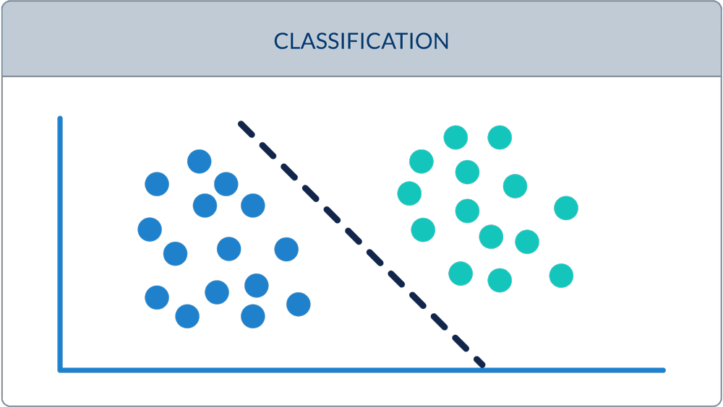
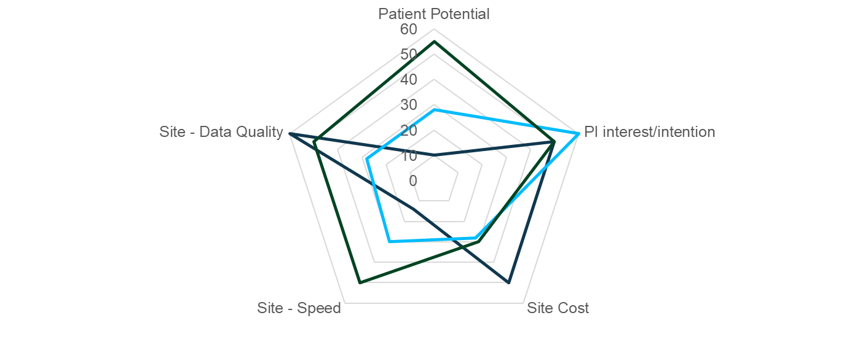
Task 3- Key modules to make decisions
Identifying engine
This is to identify key factors or determinants to be low performing or high performing sites
Translate the business needs into a classification model
Feature identification, incl. site performance, patient potential and investigator profile.
Scoring engine
Leveraging the external data and internal data, assign a score for each feature according to the quantiles, e.g. the sites with top 10% of patients size is assigned into 10, then 9 etc.
Set up the weight of each feature by Analytical Hierarchy Process to calculate the weights of each feature
Final scoring system will be score*weight
Recommendation engine
Recommend according to identification and scoring
Pick up the sites considering the regional distribution
Comments added
>1 patients
0-1 patients

Slide 48
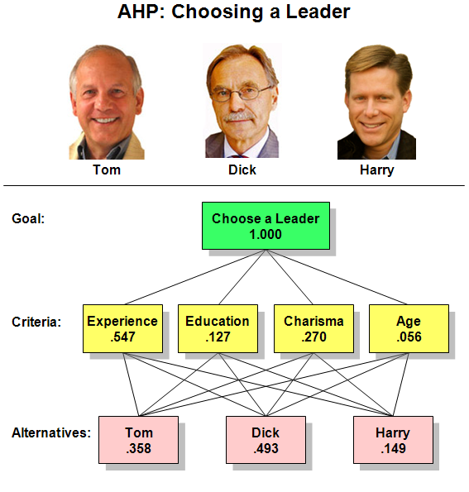
Task 3 - AHP
The Analytic Hierarchy Process (AHP), developed by Saaty in the late 1970s, is one of the methods for multi-criteria decision making. The AHP disaggregates a complex decision problem into different hierarchical levels. The weight for each criterion and alternative are judged in pairwise comparisons and priorities are calculated by the Eigenvector method
Step 1. Define the Problem
Step 2. Develop a Hierarchical Framework
Step 3. Construct a Pair Wise Comparison Matrix
Step 4. Perform Judgment of Pair Wise Comparison
Step 5. Synthesizing Pair wise Comparison
Step 6. Perform the Consistency
Step 7. Step 3 To 6 are Performed for All Levels in the Hierarchy Model
Step 8. Develop Overall Priority Ranking
Step 9. Select the Best Alternative

Slide 49

Thank you!
Bye-Bye

